Slide 1



  G H RAISONI COLLEGE OF ENGINEERING AND MANAGEMENT
(Approved by AICTE, New Delhi and Recognized by DTE, Maharashtra)
An Autonomous Institute Affiliated to Rashtrasant Tukadoji Maharaj Nagpur University, Nagpur
Accredited by NAAC with A+ Grade
Department of Artificial Intelligence
Introductory Project Seminar
(B. Tech 7th Semester)
On
Knowledge Graph powered multimodal RAG for Corporate sustainable Report Analysis
Guide: Project Incharge:
Prof. Umesh Lanjewar Dr. Sakshi Sadhwani
Assistant Professor Assistant Professor
Name of Projectees
Prajwal Shelkar Prajwal Dhande Purva Wagh
Radhika Bangade Pranjali Sakure Rinku Meshram
Session 2026-2027

Slide 2
Contents
Introduction
Literature Survey
Objectives of Project
Flow chart /Block Diagram
Mentor’s Suggestions (If any)
Innovative Work
Work Done (till date)
Result & Discussion (till date)
Work Plan
References

Slide 3
Introduction
Corporate sustainability reports contain text, tables, charts, figures, and KPIs distributed across many pages.
Important sustainability information is often connected across different sections of the report, making manual analysis difficult.
Traditional RAG mainly retrieves relevant text, but may fail to capture relationships between visual and textual evidence.
Multimodal RAG helps process text and visual information, while a Knowledge Graph connects related entities and evidence across pages.
Our project applies this approach specifically to corporate sustainability reports.
The system extracts and connects KPIs, targets, values, reporting periods, business segments, regions, charts, and tables.
It then performs graph-based retrieval and reasoning to analyze sustainability performance and target progress.
The results are presented through a dashboard, knowledge graph, and source-level evidence, rather than a chatbot.

Slide 4
Literature Survey
Sr. No. | Paper Title and its Author | Details of Publication | Findings
1 | Multimodal Reasoning with Multimodal Knowledge Graph – Junlin Lee, Yequan Wang, Jing Li, Min Zhang | ACL, 2024(DOI: https://doi.org/10.18653/v1/2024.acl-long.579) | Introduces MR-MKG, using Multimodal Knowledge Graphs and RGAT to enhance LLM reasoning efficiently (updates only ~2.25% of parameters). Achieves SOTA on ScienceQA and MARS. Limitations: Highly dependent on retrieval quality; prone to retrieving noisy or ambiguous sub-graphs; untested on 70B+ scale LLMs.
2 | MuRAG: Multimodal Retrieval-Augmented Generator for Open Question Answering over Images and Text – Wenhu Chen, Hexiang Hu, Xi Chen, Pat Verga, William W. Cohen | EMNLP, 2022 (Proceedings of the 2022 Conference on Empirical Methods in Natural Language Processing, pp. 5558–5570). DOI: https://doi.org/10.18653/v1/2022.emnlp-main.375 | Introduces MuRAG, which retrieves both images and text using multimodal memory. Achieves 10–20% absolute improvement over existing models on WebQA and MultimodalQA. Limitations: Visual understanding remains the main bottleneck, especially for counting, object recognition, complex scenes, and OCR.
3 | Multimodal Graph RAG for Long-range Visually Rich Document Understanding – Yi-Cheng Wang, Chu-Song Chen | arXiv, 2026 (arXiv:2606.28780) (DOI: https://doi.org/10.48550/arXiv.2202.05786) | Introduces KG4VD, integrating text, figures, and layout into a unified multimodal knowledge graph for long-range document VQA. Also introduces the DLVQA benchmark and outperforms existing MMRAG and KG-based methods. Limitations: Page-level retrieval struggles with holistic document understanding, and comprehensive document-level VQA datasets are limited.

Slide 5
Literature Survey
Sr. No. | Paper Title and its Author | Details of Publication | Findings
1 | RAG-Anything: All-in-One RAG Framework – Zirui Guo, Xubin Ren, Lingrui Xu, Jiahao Zhang, Chao Huang | arXiv, 2025 (arXiv:2510.12323) (DOI: https://doi.org/10.18653/v1/2024.acl-long.579) | Introduces a unified RAG framework for text, images, tables, and equations using dual graphs and hybrid retrieval. Shows strong performance, especially on long documents. Limitations: Suffers from text-centric retrieval bias, spatial/layout challenges, and cross-modal misalignment.
2 | VisRAG: Vision-based Retrieval-augmented Generation on Multi-modality Documents – Shi Yu, Chaoyue Tang, Bokai Xu, Junbo Cui, Junhao Ran, Yukun Yan, Zhenghao Liu, Shuo Wang, Xu Han, Zhiyuan Liu, Maosong Sun | ICLR, 2025 DOI: (10.48550/arXiv.2410.10594) | Introduces a vision-language-based RAG pipeline that directly retrieves document pages as images instead of converting them into text. Achieves 20–40% better end-to-end performance than traditional text-based RAG. Limitations: Requires vision-language models and can still face challenges with complex visual document understanding.
3 | VDocRAG: Retrieval-Augmented Generation over Visually-Rich Documents – Ryota Tanaka, Taichi Iki, Taku Hasegawa, Kyosuke Nishida, Kuniko Saito, Jun Suzuki | CVPR, 2025, pp. 24827–24837 (DOI: https://doi.org/10.48550/arXiv.2202.05786) | Presents a RAG framework designed for visually rich documents containing charts, tables, and mixed formats such as PDF and PPTX. It focuses on retrieving relevant visual document content for question answering. Limitations: Handling diverse document formats and visually complex content remains challenging.

Slide 6
Objectives of the Project
To develop a multimodal document analysis system for corporate sustainability reports.
To extract and understand text, tables, charts, figures, and document layout from long sustainability reports.
To construct a domain-specific multimodal Knowledge Graph containing KPIs, targets, values, reporting periods, business segments, regions, and evidence.
To connect related sustainability information across different pages and report sections.
To use hybrid multimodal and graph-based retrieval for finding relevant evidence.
To perform multi-step, numerical, and temporal reasoning over sustainability information.
To analyze KPI trends and target-vs-actual performance.
To maintain source-level evidence and provenance for every important analytical result.
To provide the results through a structured dashboard, knowledge graph, and evidence explorer, without using a chatbot.

Slide 7
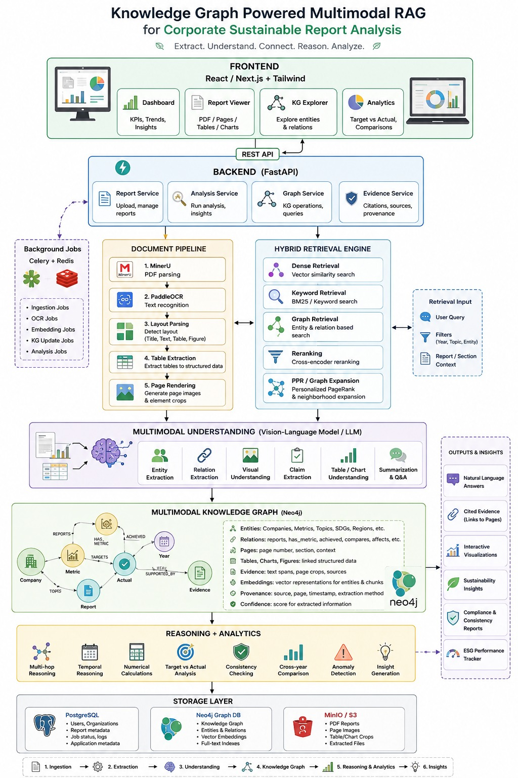
Flow Chart / Block Diagram

Slide 8
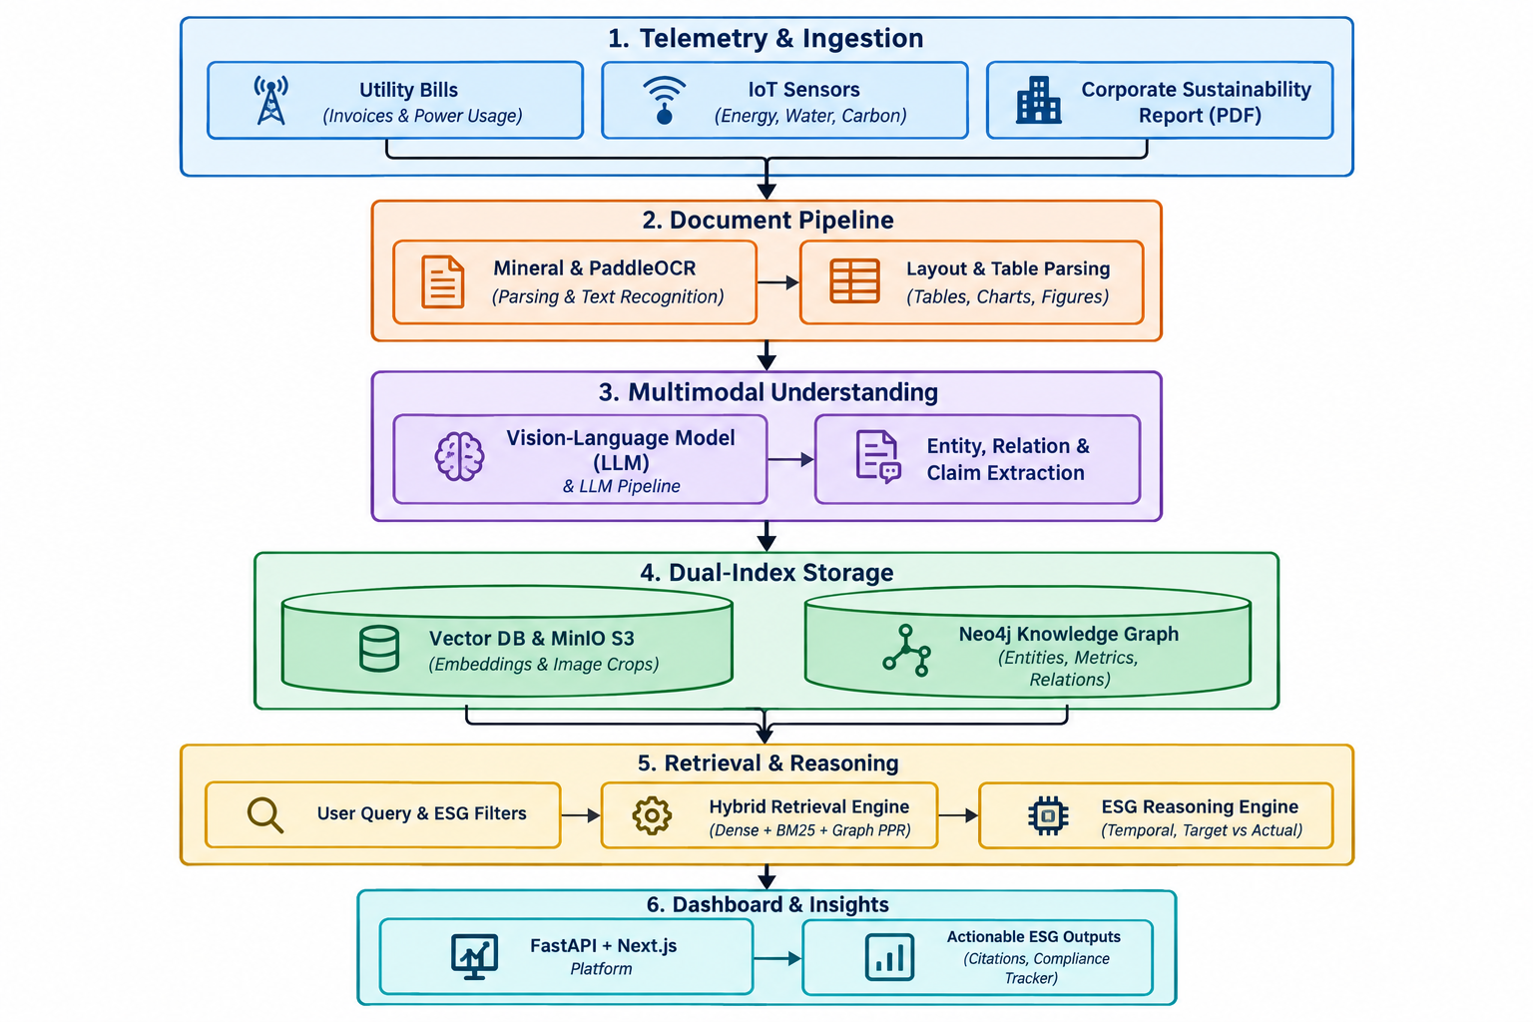
Circuit Diagram

Slide 9
Mentor’s Suggestion (if any)
Mentor’s Suggestion (if any)
Implementation comment:
2.
Implementation comment:
3.
Implementation comment:

Slide 10
Innovative Work
Multimodal Knowledge Graph-based representation connecting sustainability entities, KPIs, emission scopes, values, pages, and relationships instead of treating the PDF as isolated text chunks.
Evidence-grounded analysis with confidence scores and source-page traceability so extracted information can be inspected against the original document.
Foundation for reasoning-aware sustainability analysis, where the existing graph can be extended to support KPI–target relationships, cross-page reasoning, consistency verification, and longitudinal comparison across reports.

Slide 11
Work done (till date)
Developed the Sustainability Report Management module for uploading corporate ESG/sustainability PDF reports and tracking company, fiscal year, page count, entities, KPIs, targets, and processing status.
Implemented the Sustainability Analytics Dashboard with KPI extraction, target/entity/relationship statistics, KPI category breakdown, extraction-confidence visualization, and CSV export.
Implemented the MMKG and Evidence Explorer modules with entity–relationship visualization and source traceability, allowing extracted entities to be linked back to their originating report pages.

Slide 12
Result & Discussion (till date)
Results & Discussion (Till Date)
Multimodal report understanding of text, tables, charts, and figures.
Sustainability Knowledge Graph linking KPIs, targets, values, periods, and evidence.
Cross-page retrieval and reasoning over distributed report information.
Automated KPI, trend, and target-vs-actual analysis.
Cross-year comparison of sustainability performance and targets.
Detection of inconsistencies across text, tables, and charts.
Source-traceable results linked to the original page or document region.
Interactive dashboard and Knowledge Graph for clear sustainability analysis.

Slide 13
Work – Plan
Months Activities | JUN’26 | JULY’26 | AUG’26 | SEPT’26 | OCT’26
Literature Reviews | √ | √
Component Identification & Selection |  | √
Designing | √ | √
Fabrication |  | √ | √
Experimental Analysis |  | √ | √ | √
Testing and Debugging |  | √ | √ | √
Preparation of Project Report |  |  | √ | √
Thesis and Poster Submission

Slide 14
References
[1] Han, H., Wang, Y., Shomer, H., Guo, K., Ding, J., Lei, Y., Halappanavar, M., Rossi, R. A., Mukherjee, S., Tang, X., He, Q., Hua, Z., Long, B., Zhao, T., Shah, N., Javari, A., Xia, Y., & Tang, J. (2024). Retrieval-Augmented Generation with Graphs (GraphRAG). arXiv. https://doi.org/10.48550/arxiv.2501.00309 Cited by: 368
[2] He, X., Wang, Y., Fan, W., Li, Q., Zhang, Q., Chang, Y., & Wang, X. (2026). HVM-GraphRAG: Holistic-View Multimodal Graph Retrieval-Augmented Generation on Complex Document. arXiv. https://doi.org/10.48550/arXiv.2607.24861
[3] Mei, L., Mo, S., Yang, Z., & Chen, C. (2025). A Survey of Multimodal Retrieval-Augmented Generation. arXiv. https://doi.org/10.48550/arxiv.2504.08748 Cited by: 112
[4] Mortaheb, M., Khojastepour, M. A. A., Chakradhar, S. T., & Ulukus, S. (2025). Re-ranking the Context for Multimodal Retrieval Augmented Generation. arXiv. https://doi.org/10.48550/arxiv.2501.04695 Cited by: 25

Slide 15
References
[5] Chen, Z., Zhang, Y., Fang, Y., Geng, Y., Guo, L., Chen, X., Li, Q., Zhang, W., Chen, J., Zhu, Y., Li, J., Liu, X., Pan, J. Z., Zhang, N., & Chen, H. (2024). Knowledge Graphs Meet Multi-Modal Learning: A Comprehensive Survey. arXiv., https://doi.org/10.48550/arXiv.2402.05391 Cited by 27
[6] Zhu, X., Li, Z., Wang, X., Jiang, X., Sun, P., Wang, X., Xiao, Y., & Yuan, N. J. (2022). Multi-Modal Knowledge Graph Construction and Application: A Survey. arXiv. https://arxiv.org/abs/2202.11883
Cited by 149
[7] Liu, Y., Li, H., Garcia-Duran, A., Niepert, M., Onoro-Rubio, D., & Rosenblum, D. S. (2019). MMKG: Multi-Modal Knowledge Graphs. arXiv. https://doi.org/10.48550/arXiv.1903.05485 Cited by 284
[8] Peng, J., Hu, X., Huang, W., & Yang, J. (2023). What Is a Multi-Modal Knowledge Graph: A Survey. Big Data Research, 32, 100380. https://doi.org/10.1016/j.bdr.2023.100380 Cited by 25

Slide 16
References
[9] Han, H., Wang, Y., Shomer, H., Guo, K., Ding, J., Lei, Y., Halappanavar, M., Rossi, R. A., Mukherjee, S., Tang, X., He, Q., Hua, Z., Long, B., Zhao, T., Shah, N., Javari, A., Xia, Y., & Tang, J. (2024). Retrieval-Augmented Generation with Graphs (GraphRAG). arXiv. https://doi.org/10.48550/arXiv.2501.00309 Cited by 21
[10] Hsiao, C.-H., Wang, Y.-C., Lin, T.-S., Yeh, Y.-R., & Chen, C.-S. (2026). MegaRAG: Multimodal Knowledge Graph-Based Retrieval Augmented Generation. Proceedings of the 64th Annual Meeting of the Association for Computational Linguistics (ACL 2026), 48031–48059. https://doi.org/10.18653/v1/2026.acl-long.2218 Cited by 0
[11] Park, H., Seo, J., Mun, J., Park, H., Byeon, W., Kim, S. J., Im, H., Lee, J., & Kim, S. (2026). M³KG-RAG: Multi-hop Multimodal Knowledge Graph-enhanced Retrieval-Augmented Generation. Proceedings of the IEEE/CVF Conference on Computer Vision and Pattern Recognition (CVPR 2026), 14968–14978.
CVPR Open Access Paper Cited by 0
[12] Dai, S., Huang, Q., You, X., & Yu, J. (2026). MG²-RAG: Multi-Granularity Graph for Multimodal Retrieval-Augmented Generation. arXiv. https://arxiv.org/abs/2604.04969 Cited by 13

Slide 17
References
[13] Wan, X., & Yu, H. (2025). MMGraphRAG: Bridging Vision and Language with Interpretable Multimodal Knowledge Graphs. arXiv. https://arxiv.org/abs/2507.20804 Cited by 10
[14] Liu, J., Meng, S., Gao, Y., Mao, S., Cai, P., Yan, G., Chen, Y., Bian, Z., Wang, D., & Shi, B. (2025). Aligning Vision to Language: Annotation-Free Multimodal Knowledge Graph Construction for Enhanced LLMs Reasoning. Proceedings of the IEEE/CVF International Conference on Computer Vision (ICCV 2025), 981–992. ICCV Open Access Paper Cited by 17
[15] Liu, J., Fan, D., Ji, C., Zha, D., & Tan, Q. (2026). GraphVLM: Benchmarking Vision Language Models for Multimodal Graph Learning. Proceedings of the IEEE/CVF Conference on Computer Vision and Pattern Recognition (CVPR 2026), 9491–9500. CVPR Open Access Paper Cited by 2

Slide 18
Thank you !
Nagpur | Pune | Jalgaon | Amravati | Pandhurna | Bhandara

